Slide 1
Disability Representation in “Glee”
Libby Wruck & Shelby Steele

Slide 2
Thesis: Glee uses disabled characters, such as Artie, who is in a wheelchair, Emma, who has OCD, a deaf high school choir, and Tina, who has anxiety and a stutter, to further able-bodied characters and to push forward a “woke” narrative without giving disabled characters real representation.

Slide 3
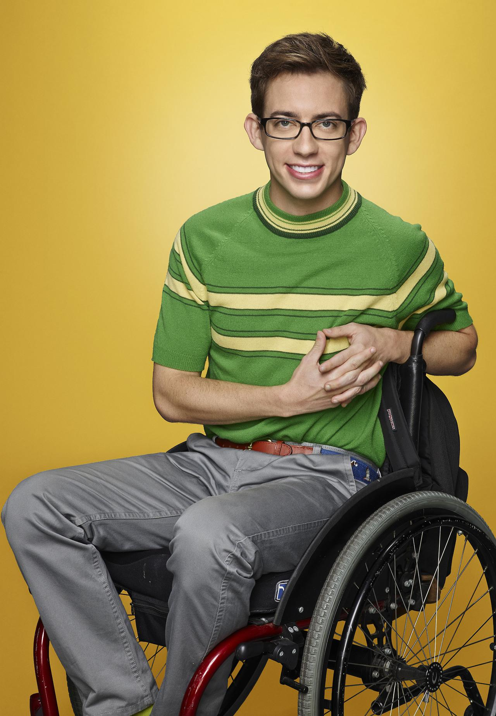
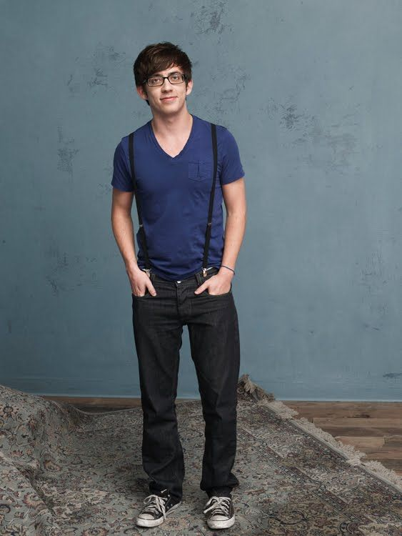
Artie
Wheelchair-bound/paralyzed
Actor is fully able-bodied

Slide 4
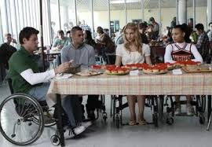
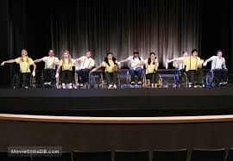
Wheelchairs for Sympathy
All the characters are put in wheelchairs to learn about Artie’s burden
Use wheelchairs in choreography for “woke points”

Slide 5
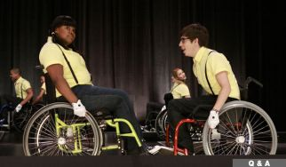
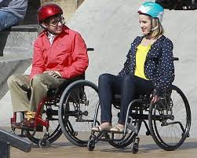
Used for Development
Classmates have to raise money through a bake sale to help pay for a handicapped bus to take Artie to their competition
  This is used solely for the development and bettering of the other characters, like a teaching moment
Fin, one of the main characters, proves he is a good person and not just a “football jock” by pulling Artie out of a portapotty

Slide 6
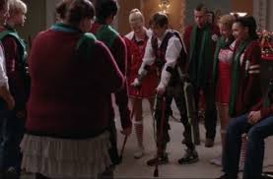
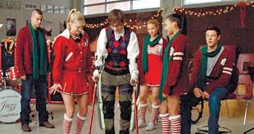
Pressured into Trying to Become Able-Bodied
Artie feels bad about being in a wheelchair and attempts to use crutches
*photos are from season 2 when he attempts for the second time

Slide 7
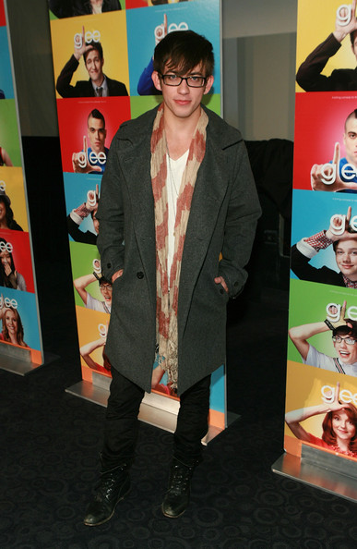
Character is Played by an Able-Bodied Actor
Played by an actor who can walk and he does multiple dance performances throughout the show in Artie’s imagination

Slide 8
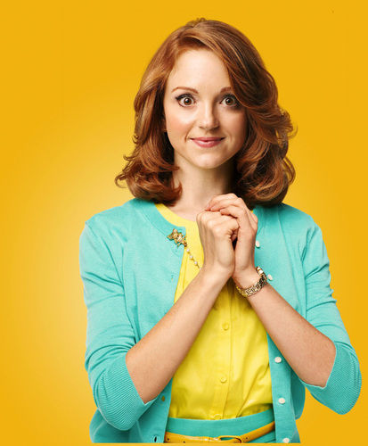
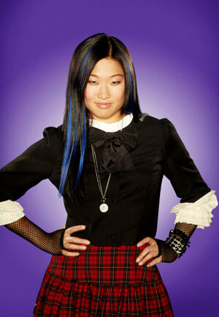
Emma & Tina
Emma, the school guidance counselor, has OCD
Tina has anxiety, causing her to create a fake stutter

Slide 9
Tina’s Fake Stutter
Tina’s defining character traits are her shyness and her stutter, so imagine everyone’s shock when the stutter turned out to be fake. Artie in particular was hurt by this discovery because the two of them had bonded over their disabilities only for him to discover she was lying. This betrayal actually shows the importance of friendships between disabled people, and how its damaging to pretend to be disabled. In the end, Tina learns confidence from her friendship with Artie and is no longer shy so she is able to leave the stutter behind, while Artie is left in his wheelchair.
Impact on others with disabilities
Using it for self gain

Slide 10
The Show’s Poor Representation of OCD
Emma’s OCD during the first season is treated as if she was just a neat freak. This neat freak image is damaging to people who actually have OCD because it downplays how debilitating the disorder can be. In a later season Will (Emma’s boyfriend at that point) sings ‘Fix You’ after she has a particularly bad attack. This is bad because this show presents a narrative that states mental disabilities are something that need to be fixed. This not how you should deal with OCD.
Emma’s ocd was caused by her falling in cow sewage once as a child
  This, if anything, would cause PTSD, not OCD
Will sings “Fix You” to Emma referring to her OCD, basically saying she’s broken and needs to be fixed

Slide 11
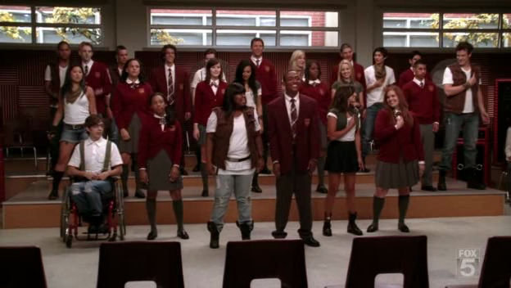
The Deaf School/Choir
A school for the deaf comes to Mckinley High (home of the main Glee club) to perform for them before they compete in Sectionals

Slide 12
“Teaching Moment”
Characters laugh when they are told they will compete against deaf school, not taking them seriously. Will, their teacher, uses this as a teaching moment. He invites the deaf school to McKinley High School to perform. The deaf schools performance inspires the glee club to “better” themselves and they change their attitude.
Used to “better” the main characters
Singing used as “tear-jerker”

Slide 13
More Poor Representation
This is a deaf singer using sign language to sing Moana’s “How Far I’ll Go”
This is a deaf choir’s surprise performance for Christmas
This is how the choir should have performed in Glee, as it is more accurate and just as “touching”
Though the deaf soloist is played by an actor who is deaf in real life, many deaf choirs actually sing with just their hands

